Slide 1
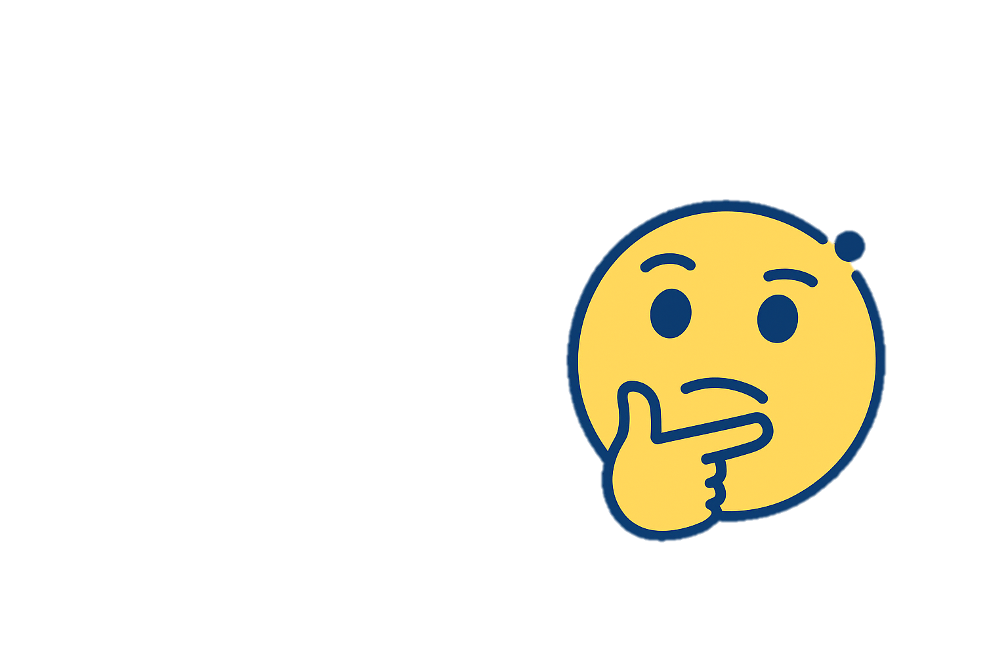
NUMBER GUESSING
NAME: VEERA BABY ALEKHYA
MICRO IT PROJECT

Slide 2
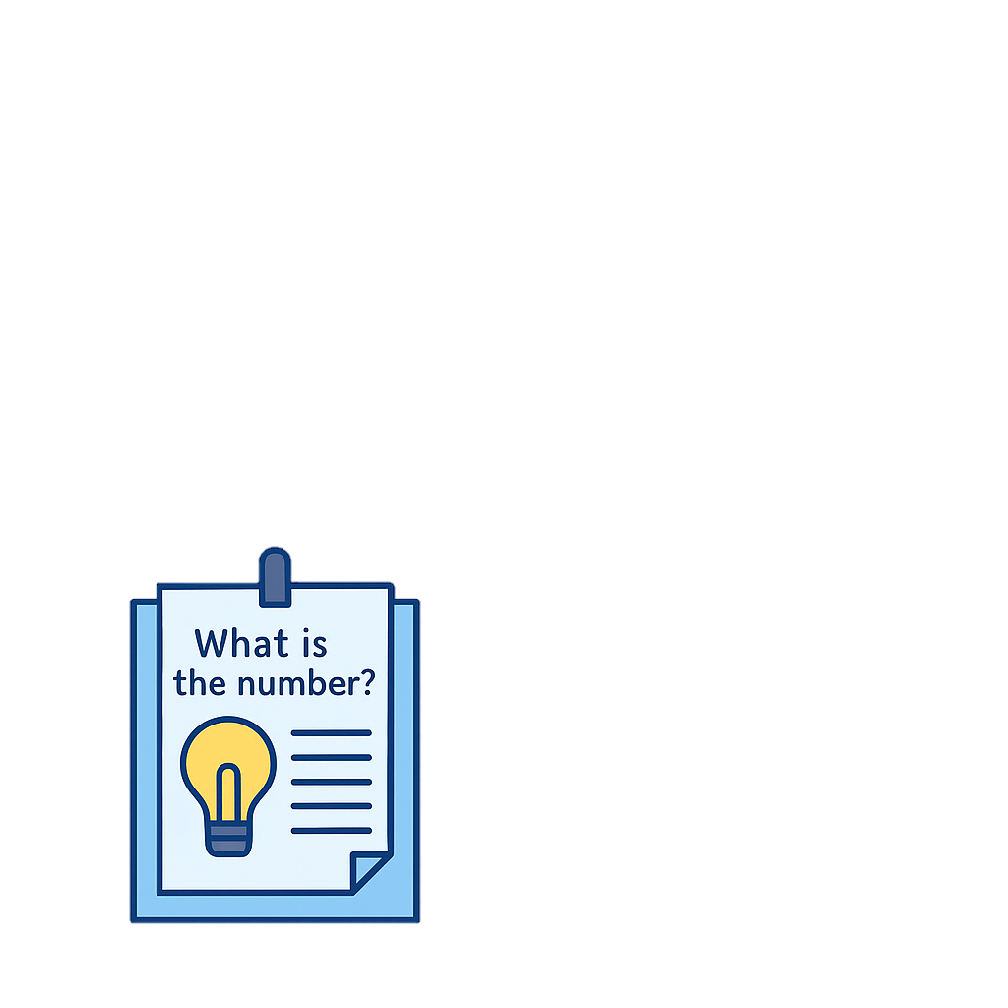
📘 Introduction
The Number Guessing Game is a console-based Python game.
The player guesses a random number between 1 and 100 within limited attempts.
The game gives feedback on each guess (Too high / Too low / Correct).

Slide 3
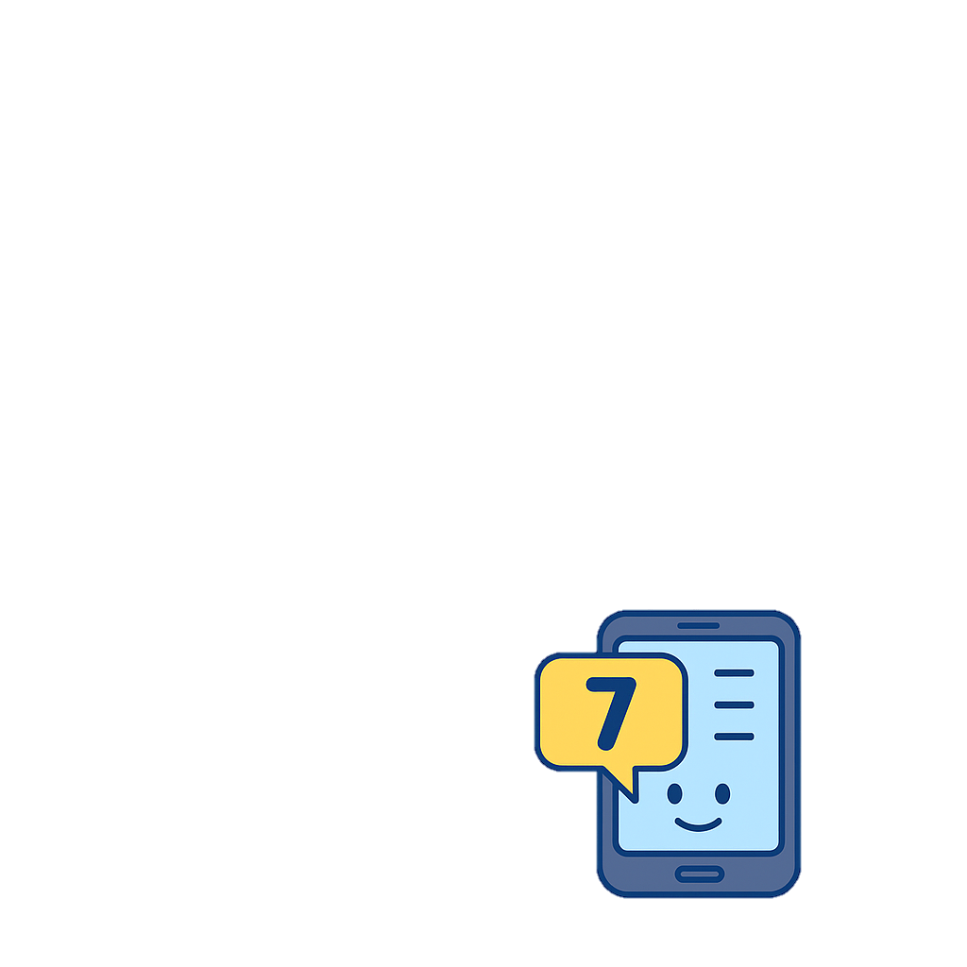

🎯 Objective of the Project
- Learn core Python programming concepts
- Understand conditional logic and loops
- Implement a fully functional console game
- Handle user input and feedback flow

Slide 4
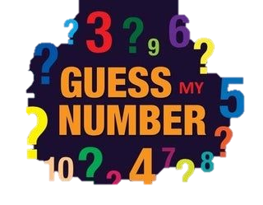



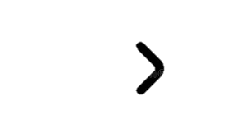
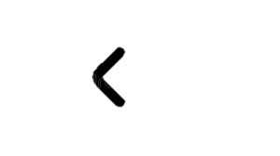
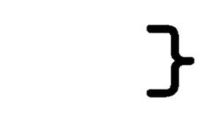
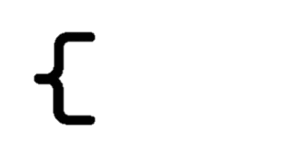
🛠️ Tools and Technologies Used
- Language: Python 3.x
- IDE: VS Code / Py Charm
- Platform: Console Application
- Libraries: random, input/output handling

Slide 5
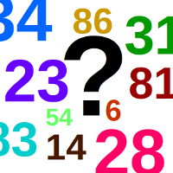
📋 Game Flow
- Game starts with a random number generated by the system
- Player enters guesses within 7 attempts
- Game gives feedback (Too high / Too low / Correct)
- If correct or attempts exhausted, game ends
- Replay option provided

Slide 6
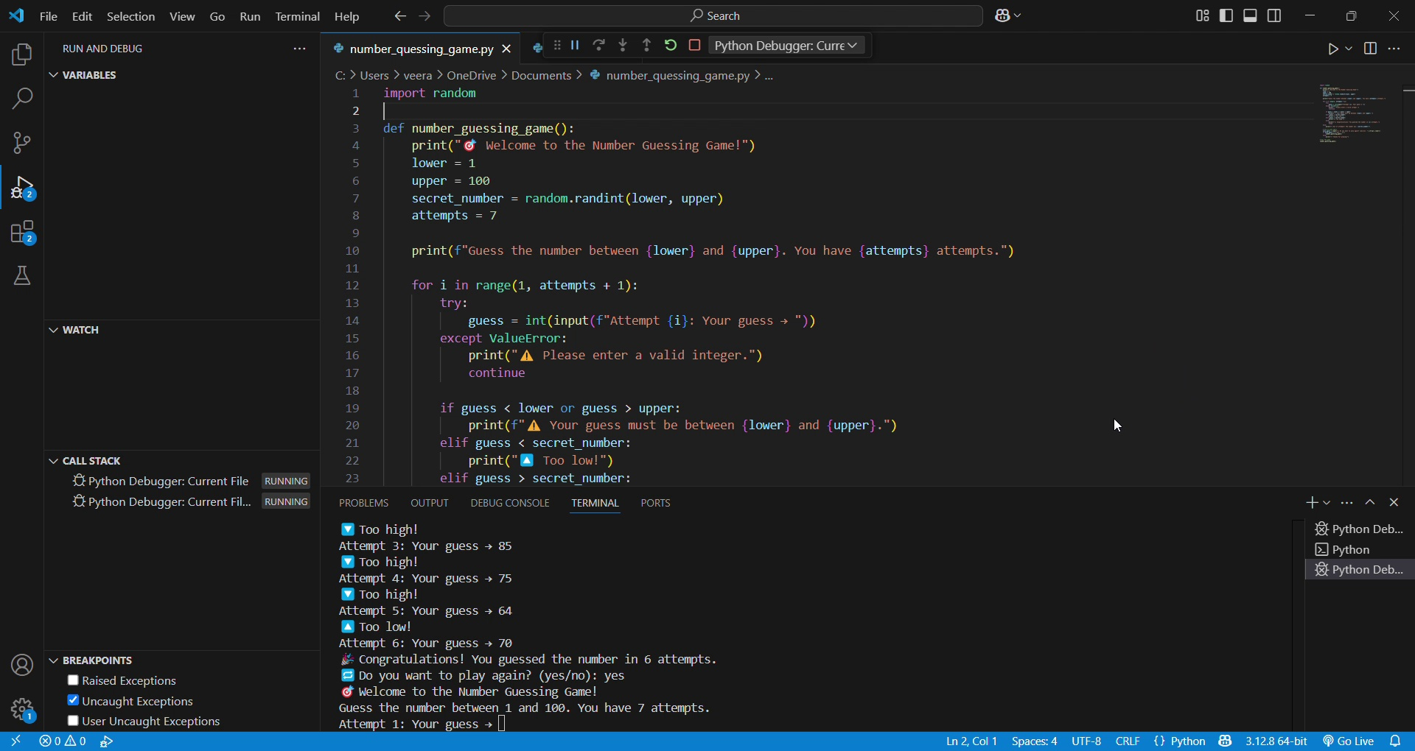
📷 Terminal Screenshot

Slide 7
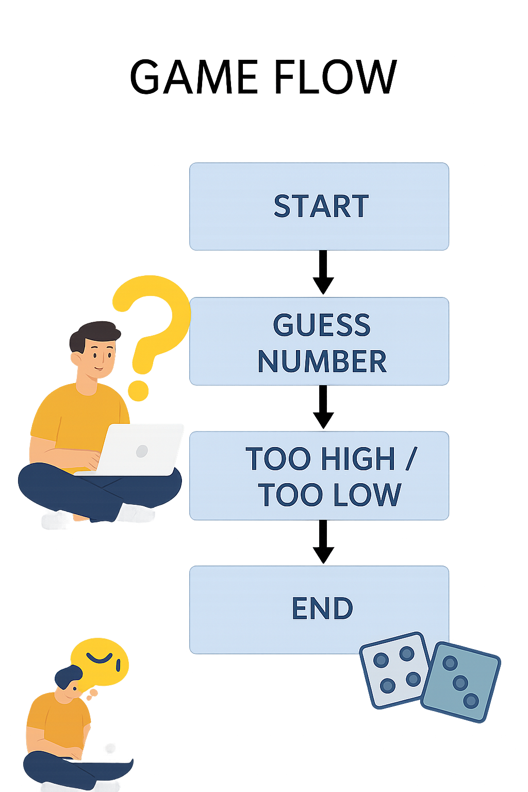
🧾 User Interface Design
- Text-based console input/output
- Clear prompts and feedback messages
- Clean formatting with emojis and step guidance

Slide 8



⚙️ Implementation Details
- Uses `random.randint()` to generate the number
- Loops and conditionals manage guesses and feedback
- Replay handled with recursive function call
- Input validation ensures only integers are processed

Slide 9
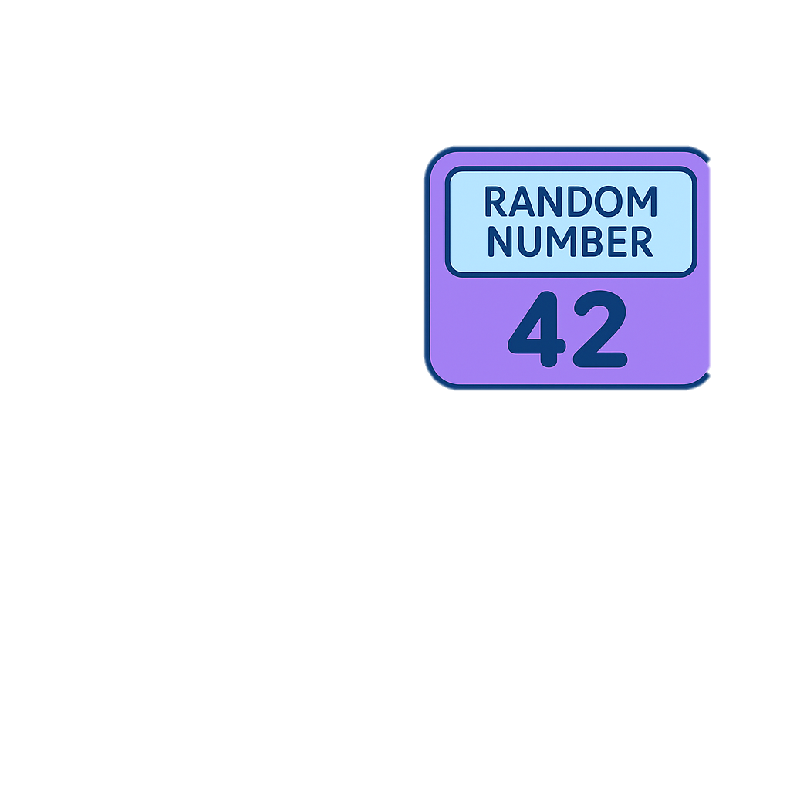
🚧 Challenges Faced
- Validating user input and preventing crashes
- Ensuring clear feedback for each guess
- Preventing duplicate prompts after win/loss
- Designing smooth replay flow

Slide 10
📚 Learning Outcomes
- Improved understanding of loops and conditionals
- Learned input validation and error handling
- Practiced modular and recursive programming
- Gained confidence in small Python project delivery

Slide 11

✅ Conclusion
This project helped strengthen Python fundamentals.
Despite being a simple game, it involved logical design, user interaction, and good coding practices.
The experience was educational and rewarding.

Slide 12

🔮 Future Scope
- Add difficulty levels (Easy, Hard)
- GUI version using Tkinter
- Maintain score history across games
- Add sound effects or animations

